Slide 1
Real-time Traffic Signs Detection
Introduction
Solution
Results and Discussion
Improvement

Slide 2
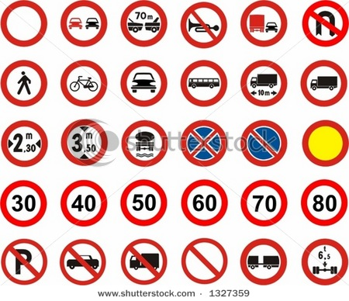
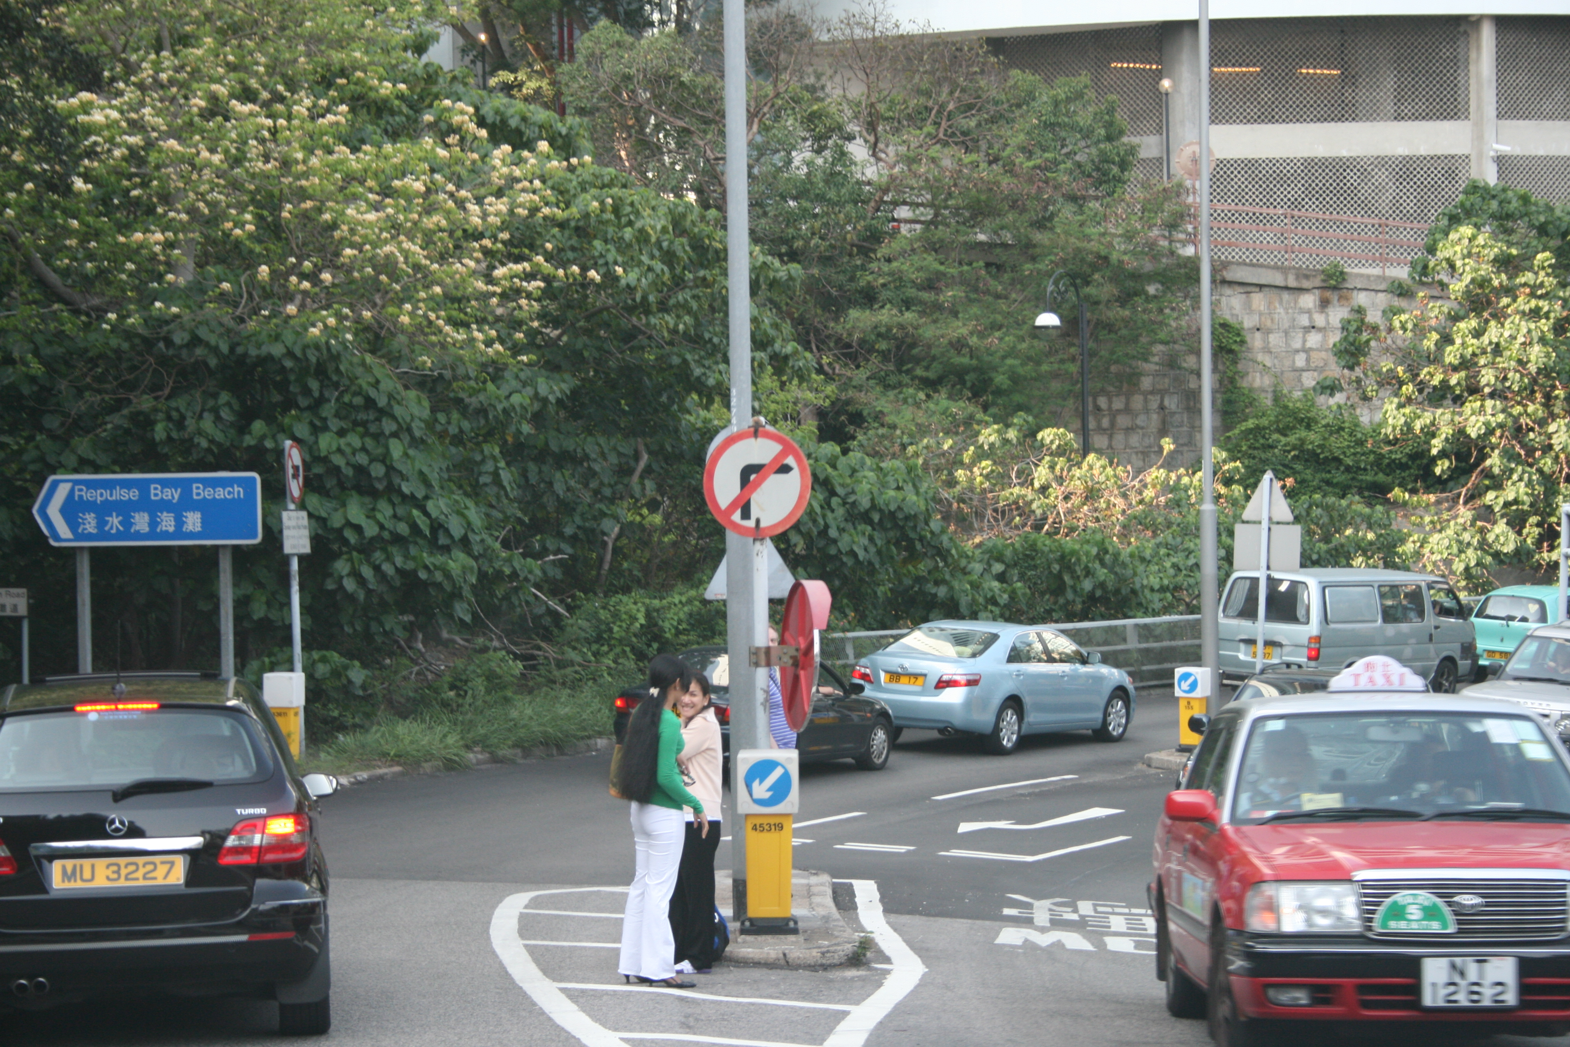
Introduction
Traffic signs
Traffic signs in the real-world

Slide 3

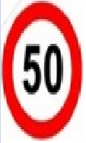
Introduction
The potential problems:
  Noisy background.
  Shape change when observing from side,
  like circle → ellipse
  Low cost, so it could be deployed in real-time systems.

Slide 4
Solution
Need 4 steps to compute result.
  Color Threshold
  Draw Contours
  Corner Detection(optional)
  Shape Recognition
    Circle
    Ellipse
    Triangle
    Other polygons ...

Slide 5
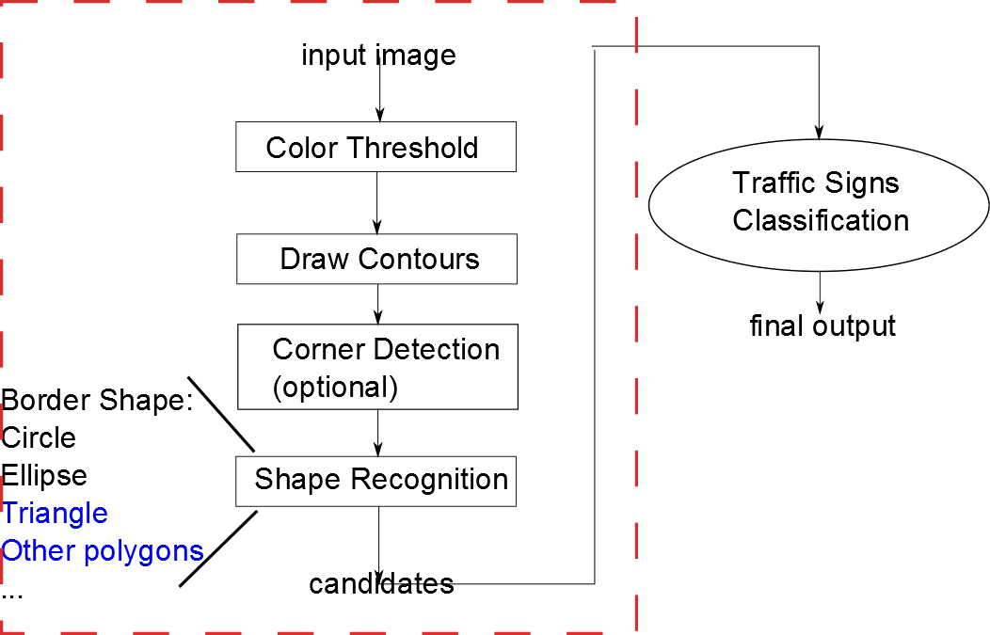
Solution

Slide 6

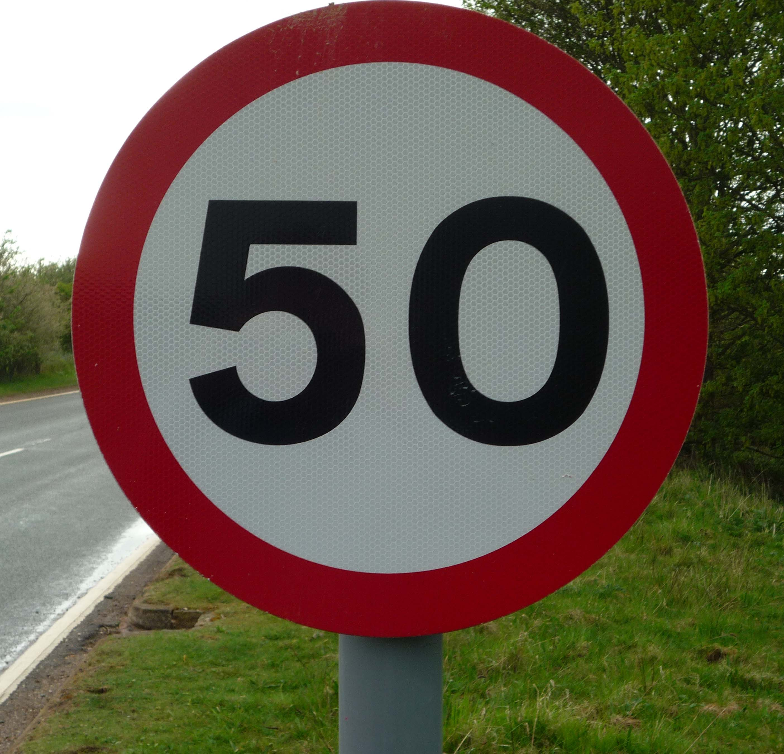
  Color Threshold
The common characteristics for most traffic signs
  Conspicuous and constant color, like red, yellow, orange...
  Regular shape and wide border

Slide 7
  Color Threshold
Two techniques to separate traffic signs from other irrelevant signals
  Color threshold
  Shape detection
In this project, the color threshold will be applied first
  Reason: it could filter more signals from raw image.

Slide 8

  Color Threshold
Problem: RGB metric system could be easily impacted by amphibians light change, like shadow or sunshine
covered by shadow
To solve it, convert it to HSV or HSL metric.
Sample a point of border
RGB = [49, 22, 37]

Slide 9
HSV/HSL metric
Composed by 3 elements, fewer impact from light change than RGB.
  Hue
  Saturation
  Lightness
How to set the color threshold in HSV/HSL?

Slide 10

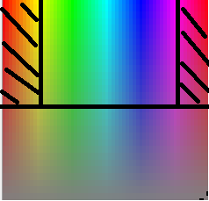
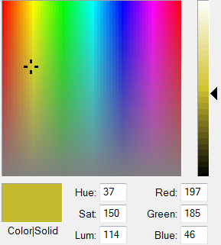
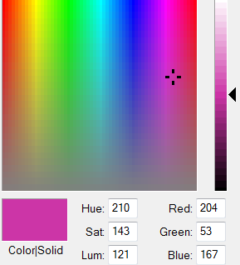
HSV/HSL metric
Color spectrum
What's the specific value of this range in HSV/HSL metric? Use some color tools:
Range:
[H,S,V] = [0~20, 50~255, 50~255] and
[150~179, 50~255, 50~255]
To filter color red

Slide 11
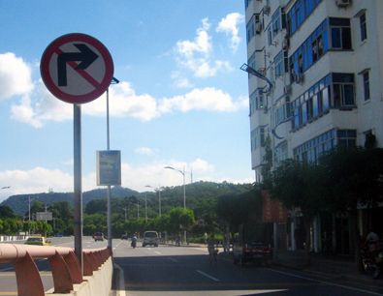
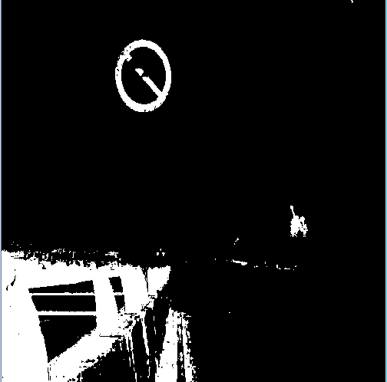
  Color Threshold
Demonstration:
raw image output
Color threshold

Slide 12
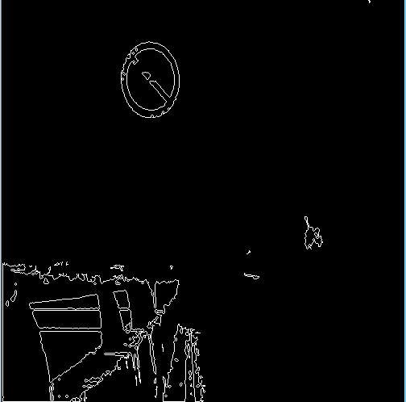
Draw Contours
Motivation: we can not deploy shape recognition based on separated points.
Demonstration:
Output: a set of objects, and the object is composed by several points
Find and draw
contours

Slide 13
Shape Detection
Sorts of shape detections
  Circle detection
  Ellipse detection
  Triangle detection
  …
In this case, we will use only circle and ellipse, and circle could be treated as special case of ellipse, so we will deploy Ellipse detection.

Slide 14
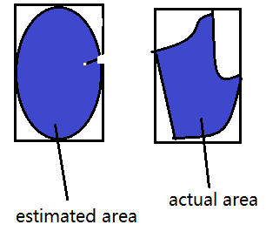
Ellipse Detection
3 Techniques to fit ellipse:
  Compare actual area, to estimated area
  Actual area(aa) could be
  computed based on
  contour
  Estimated area(ea):
  ea = PI * rect.width * rect.height
  If |aa- ea| > error_threshod
  we say this shape is not a ellipse.

Slide 15
Ellipse Detection
2nd technique: Ratio of width/height of the contour
Shortcoming of previous 2 methods:
  Not always reliable
  Inaccurate
Advantages for these 2 methods:
  Fast, few computation is required
  Easy to deploy.

Slide 16
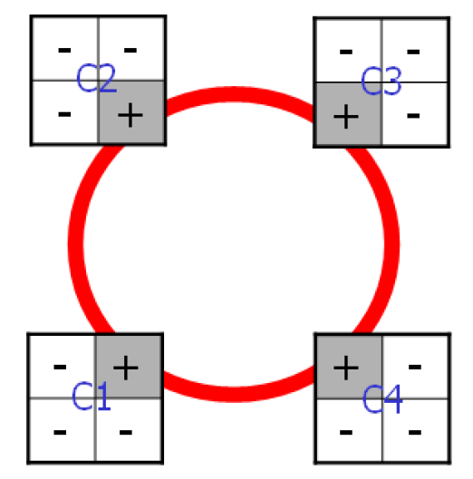
Ellipse Detection
3rd technique: corner detection.
Principle: design 4 different masks to match 4 corners of the object.
Advantages:
  Accurate
  Robust
Drawback:
  More calculation required
  than previous 2 method, need to be adapted before it is deployed in real-time system.

Slide 17
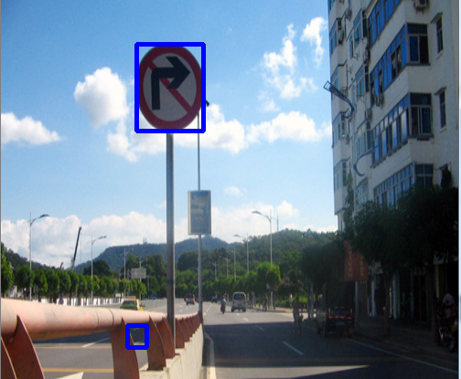
Result
Demonstration
Incorrect detection could hardly be prevented if based on current algorithm

Slide 18
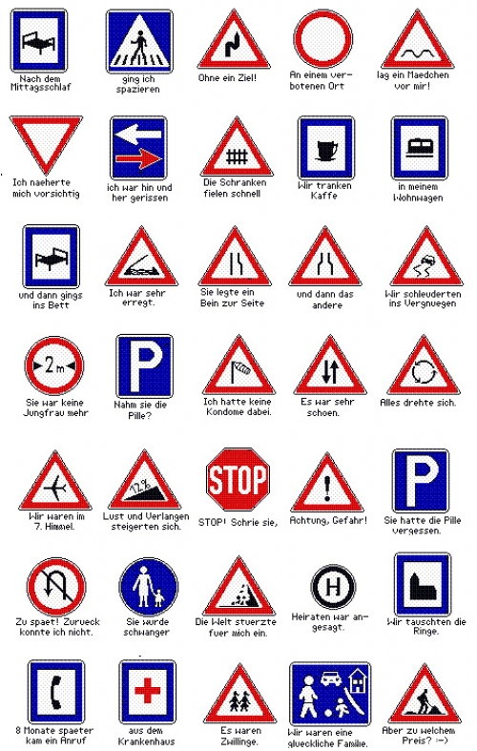
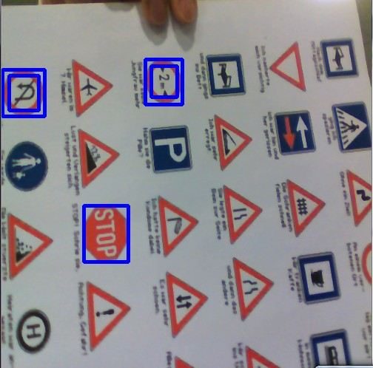
Real-time scenario
Take input from camera, treat each frame as
an image

Slide 19
Improvement
Run shape detection before color threshold to prevent rough contour edges
Adapting the algorithm of ellipse detection, one available solution is check if the object is symmetric
Improving color threshold algorithm to prevent isolated points.

Slide 20
Thank you!

